Slide 1
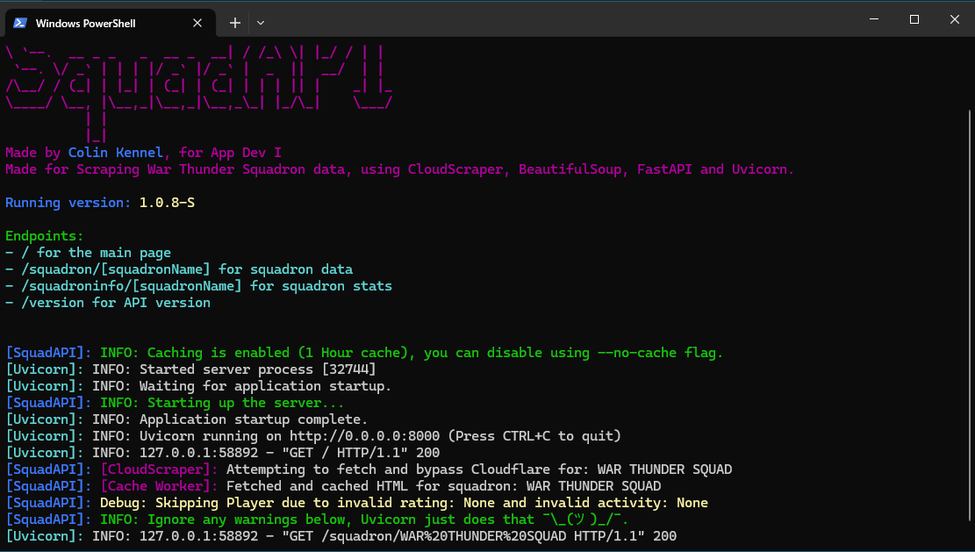
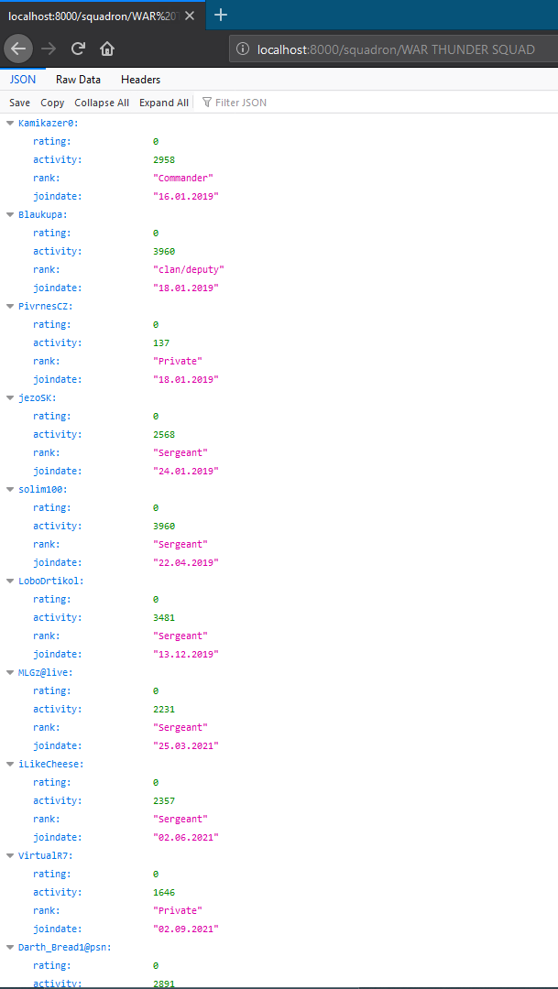

War Thunder Squad Scraper
By: Colin Kennel
SquadAPI for short is a Python based web scraper that pulls web data and turns it into a formatted JSON list
GitHub
https://github.com/ksu-is/WarThunder-SS
Pulls live data from War Thunder
JSON formatted
Easy to run
Detailed logs
CloudFlare bypass

